Slide 1
PROJECT PRESENTATION
Design and development of a mobile application for warehouse logistics management
by iker zabalegui murugarren

Slide 2
content index
Introduction
Problem
Objectives
State of the art
Description of the proposal
Architecture
Design
Features
Conclusions and future lines

Slide 3
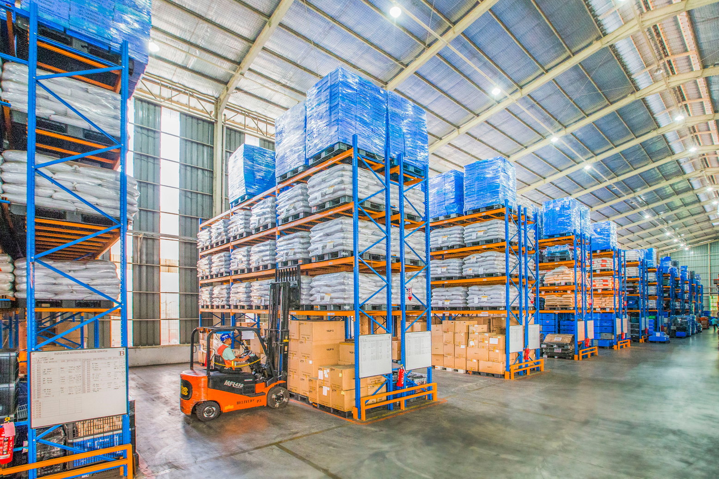
INTRODUCTION
Warehouse managment systems: a big market.
What do they do?
What?
Where?
When?
How much?
Everything up to date!

Slide 4
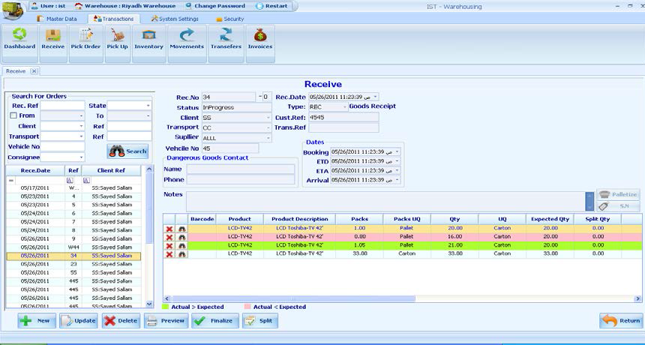
2.Problem
But there are still warehouses not managed by these systems
Loss of stock happens the company loses money
Small and medium-sized businesses
Why?
Budget
Familiarity with technology

Slide 5
3.OBJECTIVES
Objective 1:
Objective 2:
Develop a tool that can solve the logistical issues that appear when managing a warehouse
The application has to be adaptable to different types of warehouses and business fields
Objective 3:
Objective 4:
The system must be cheap to implement in any business situation
The application must be easy to use
Why?

Slide 6
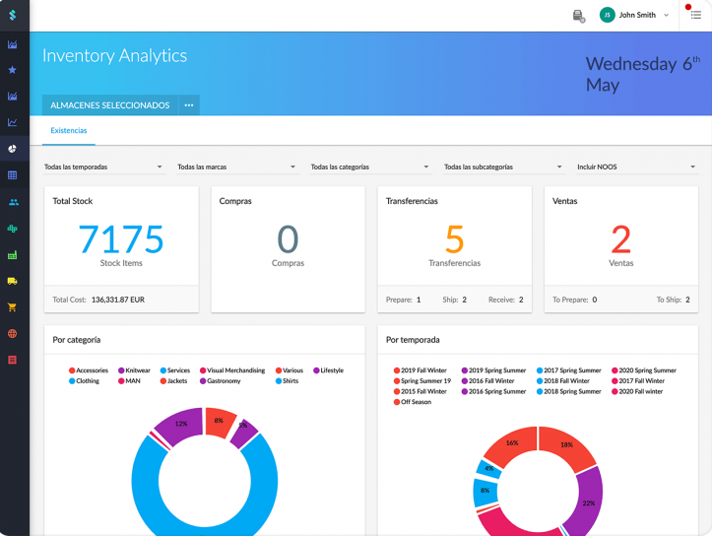
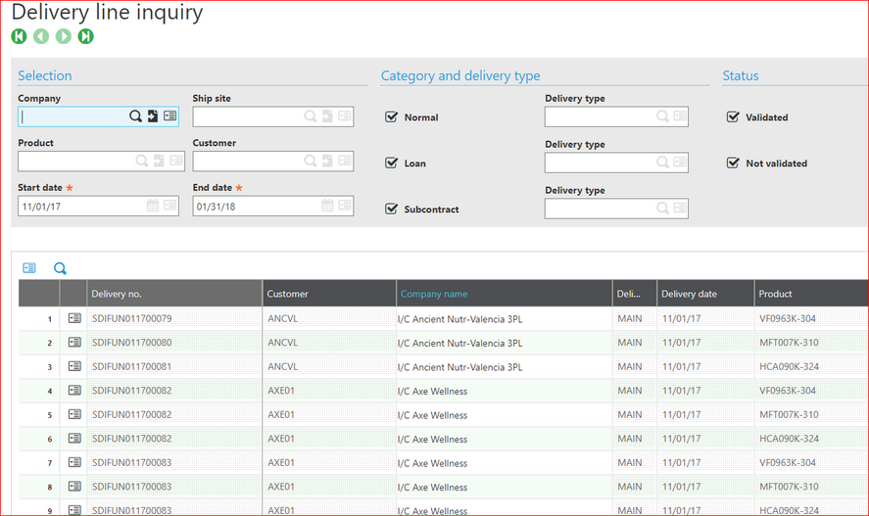
4.STATE OF THE ART
Market leaders:
Prize:
Stock Agile
Net Suite
SageX3
Oracle
Microsoft Dynamics
65$/month/user, very basic features
10000$ implementation cost
25000$/year
25000$/year
162$/month/user, basic plan
Stock Agile
SageX3

Slide 7

5.PROPOSAL
The idea:
Technologies used:
An android application that defines a warehouse managment system.
Aimed for the small and medium-sized businesses.
Easy to use.
Cheap to implement.
Android Studio
Java
XML
SQLite
QR codes
Printer

Slide 8
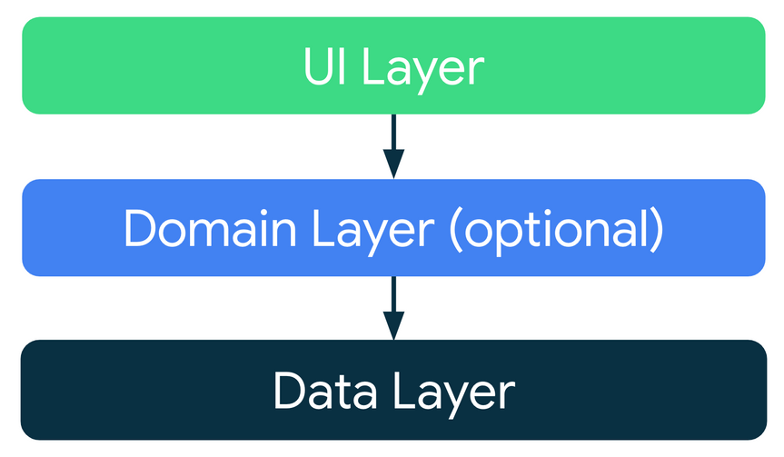
6.ARCHITECTURE
UI LAYER:
Display the application data on the screen.
Buttons, text fields, menus...
Size, shape placement...
Activities
No data saved.
Good practices:
Only app components should rely on Android framework SDK API
Well defined boundaries in modules
All parts testable in isolation
DATA LAYER:
Contain business logic
Expose the data
Database
Database manager

Slide 9
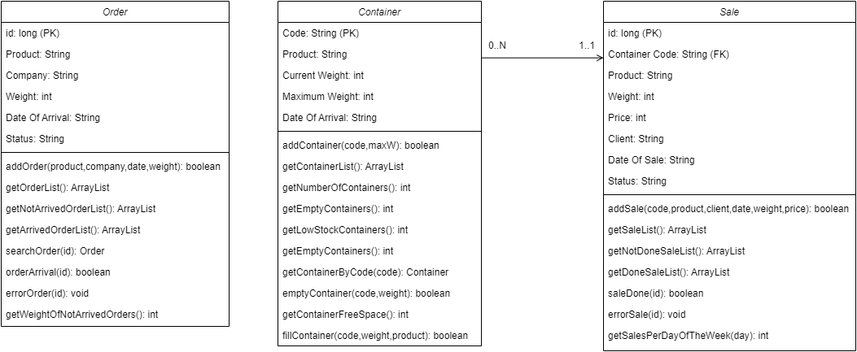
7.DESIGN
DATABASE:
Containers
Orders
Sales
DATABASE MANAGER:
The bridge between the database and the application.
The business logic.

Slide 10
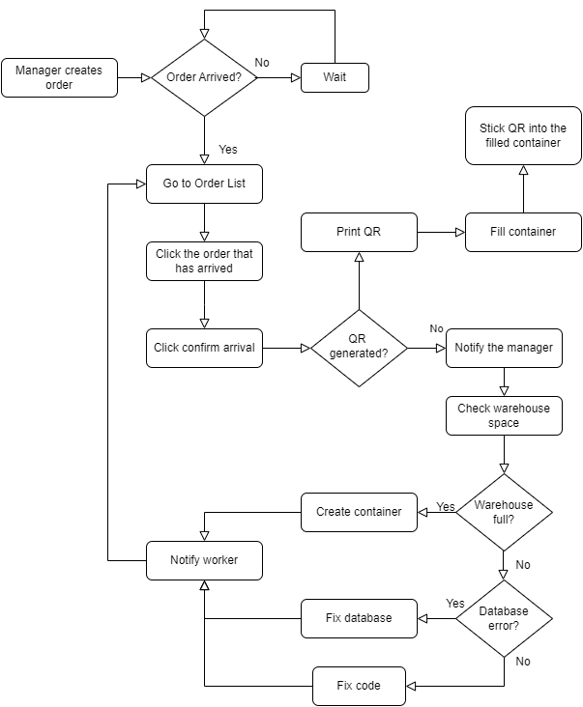
7.DESIGN
Process 1: Order arrival
Defining the process to follow when an order arrives to the warehouse
Define the resolution of any possible error.

Slide 11
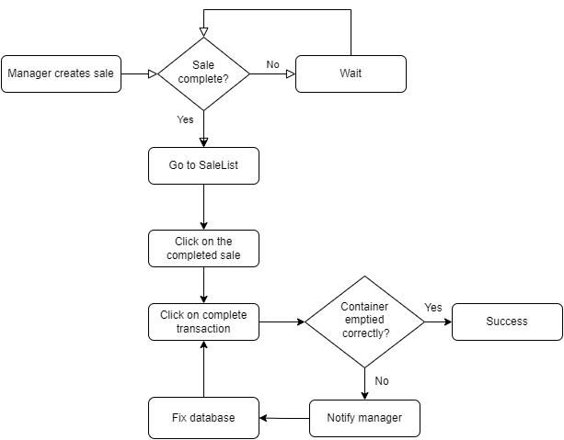
7.DESIGN
Process 2: Sale transaction

Slide 12
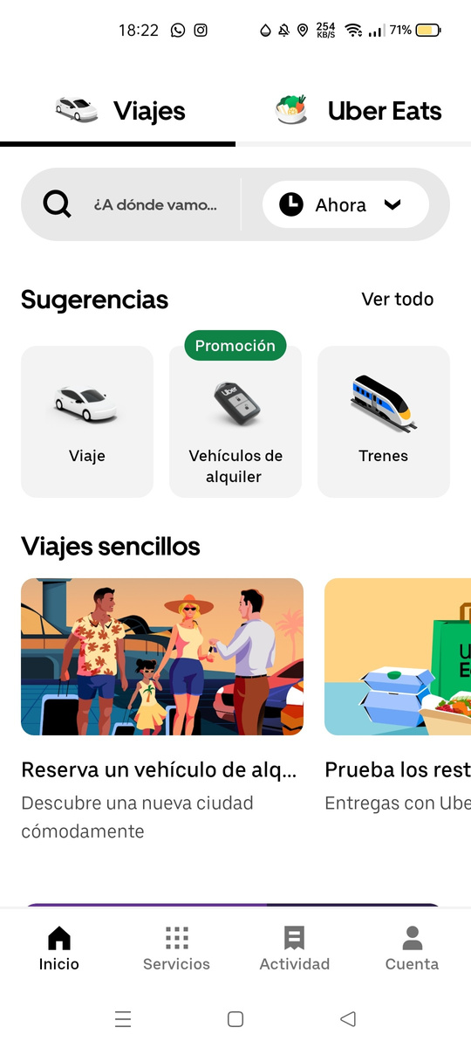
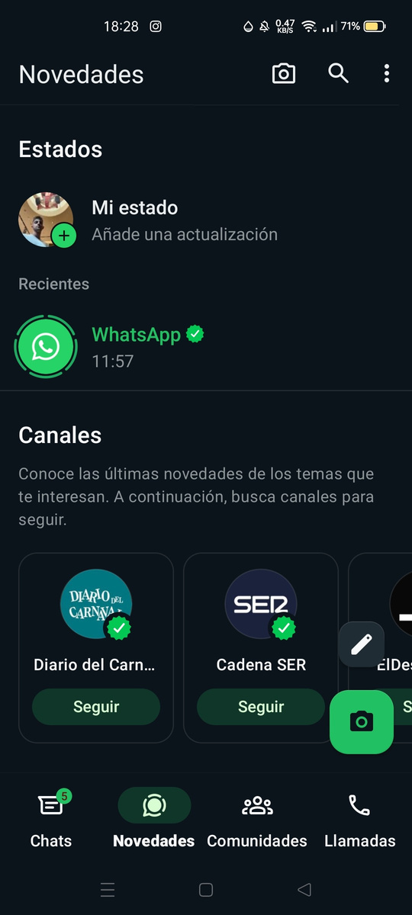
Uber
WhatsApp
7.DESIGN
UI Layer: Modern UI design
Give the users a familiar user experience.
Minimalistic design
Bottom navigation bar
Use of svg items
Familiar icons
Rounded buttons
Card views
Appropiate color palette
Text inputs

Slide 13
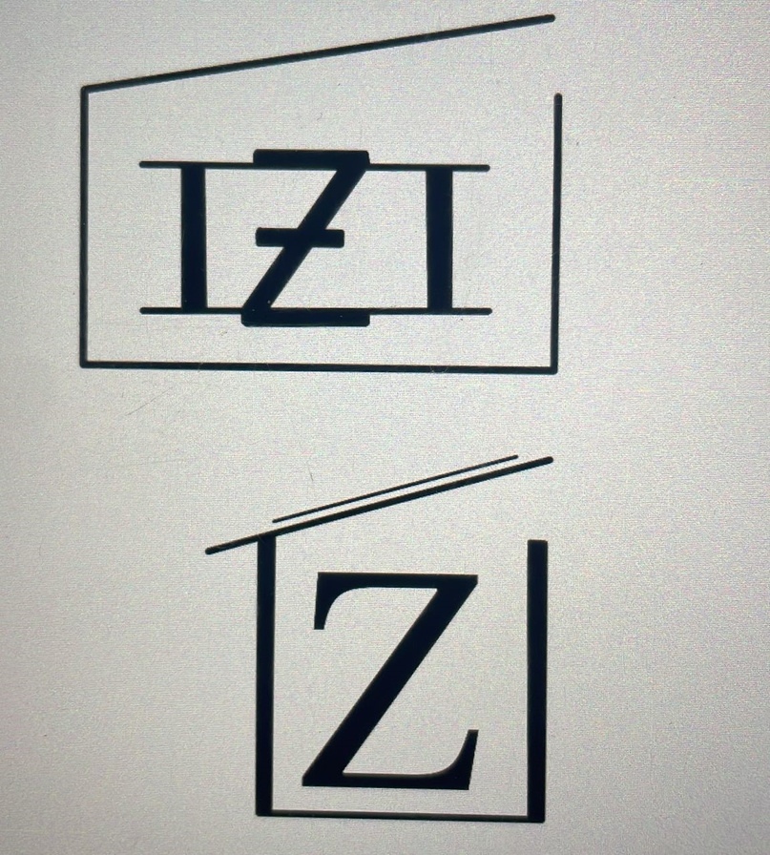
7.DESIGN
App Name: IZInventory
Represents the project’s values
The logo
The idea: represents a box or a warehouse

Slide 14
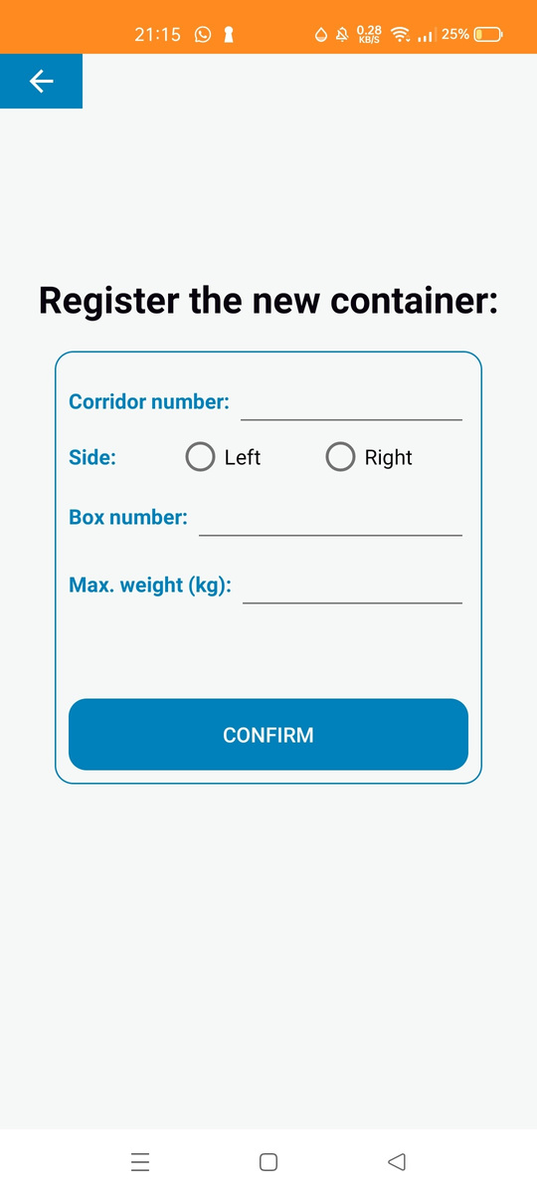
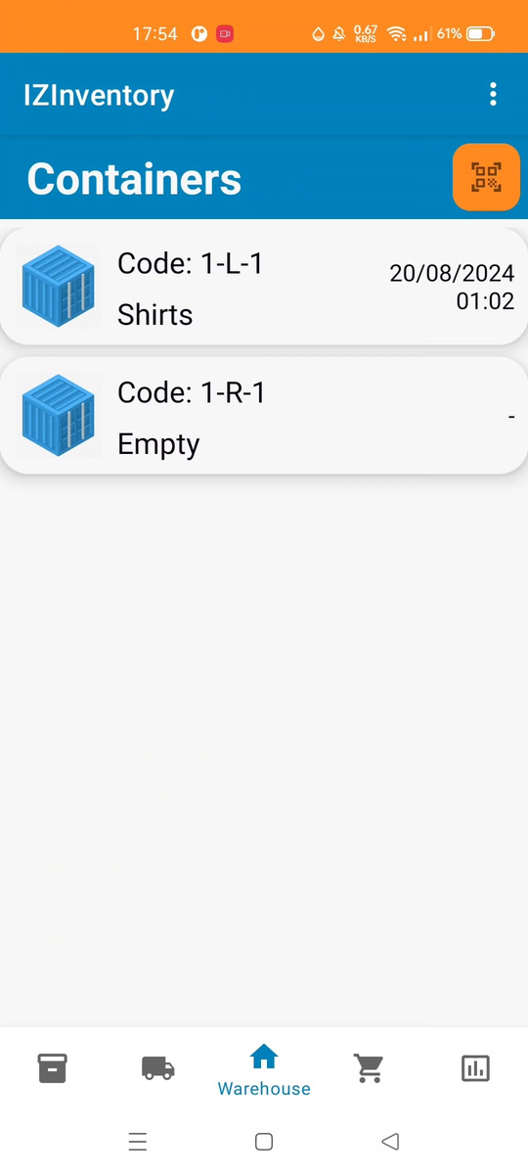
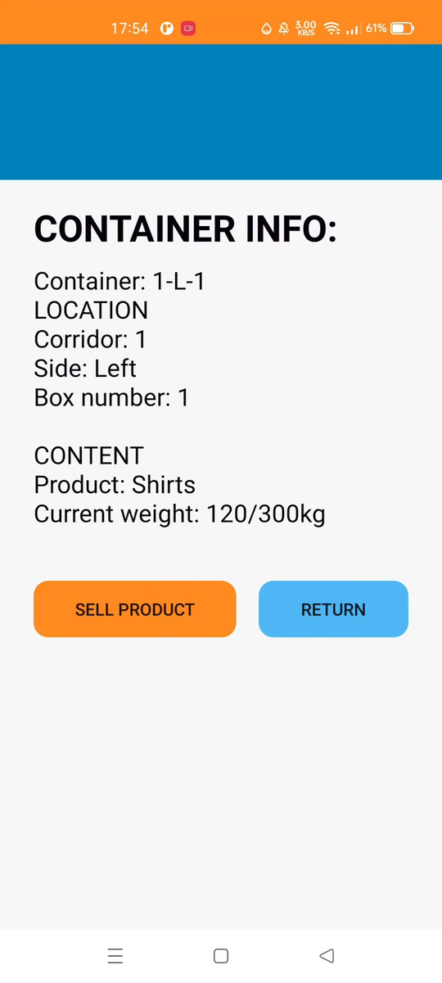
8.FEATURES: CONTAINERS
Containers:
Add Container
Container code
Container Item
Warehouse Fragment
Container Info
QR Scanner
Detection Container Info

Slide 15
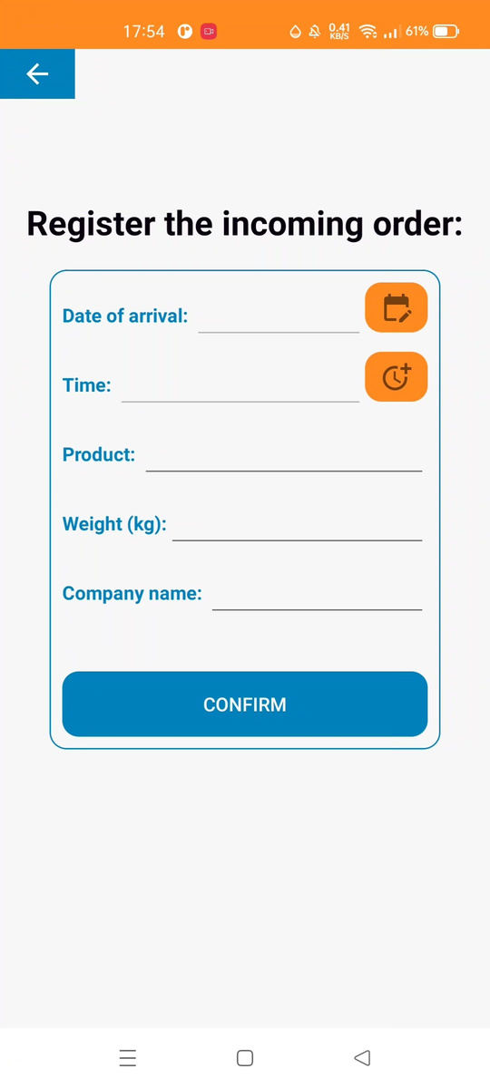
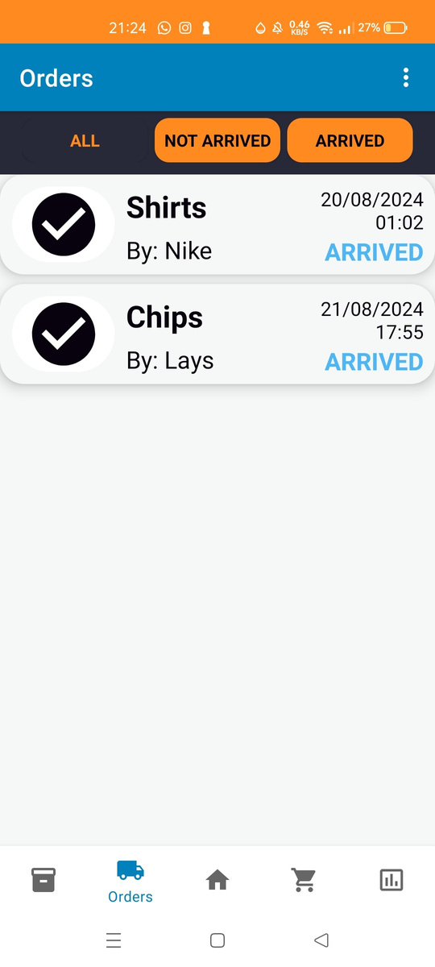
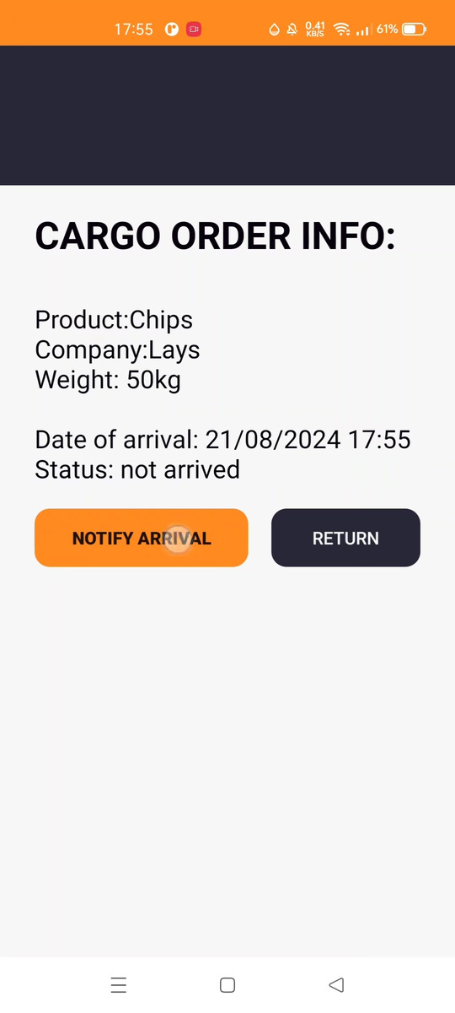
8.FEATURES: ORDERS
Orders:
Add Order
Order Item
Orders Fragment
Order Info

Slide 16
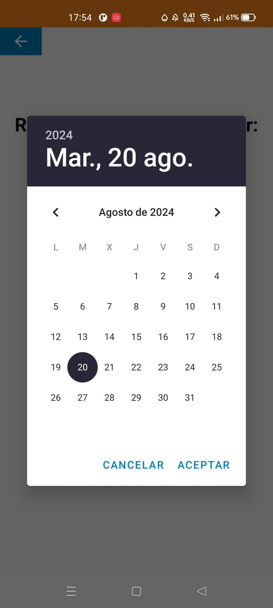
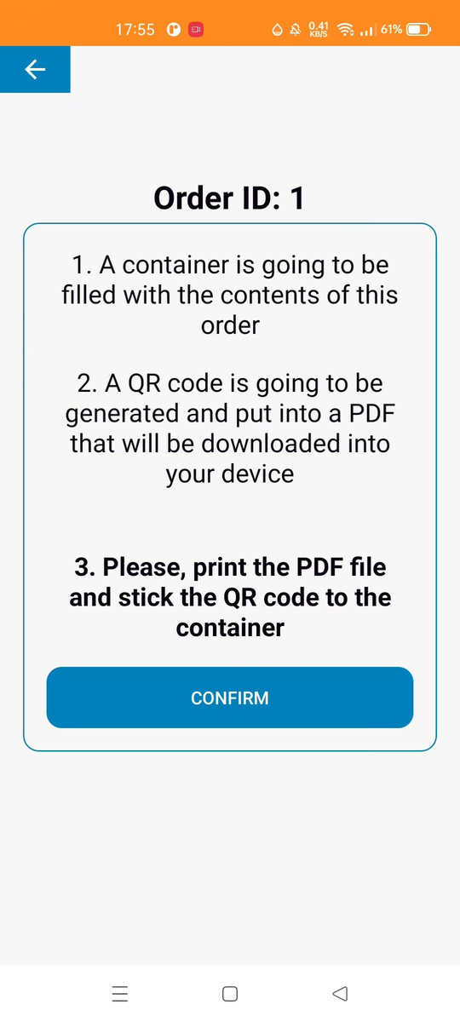
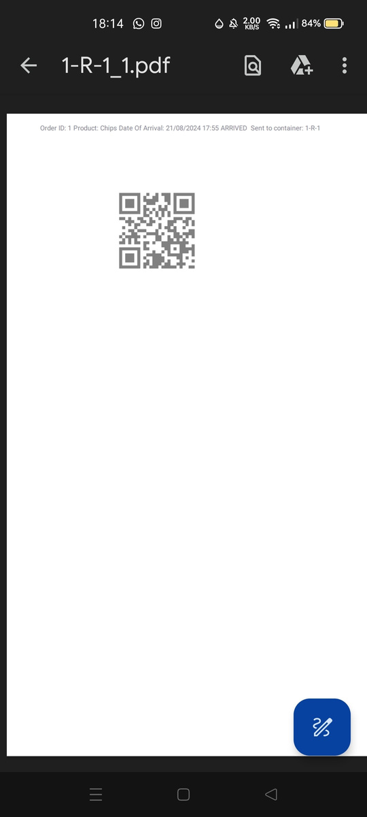
8.FEATURES: ARRIVALS
Date and time picker
Date format: dd/MM/yyyy
Time format: hh:mm
QR generation
Order arrives
Press button
QR Generation activity
Confirm
QR generated
PDF downloaded
Order status: Arrived

Slide 17
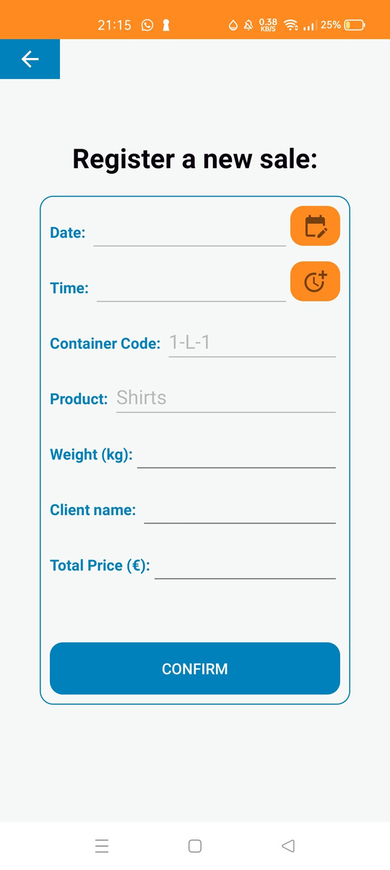
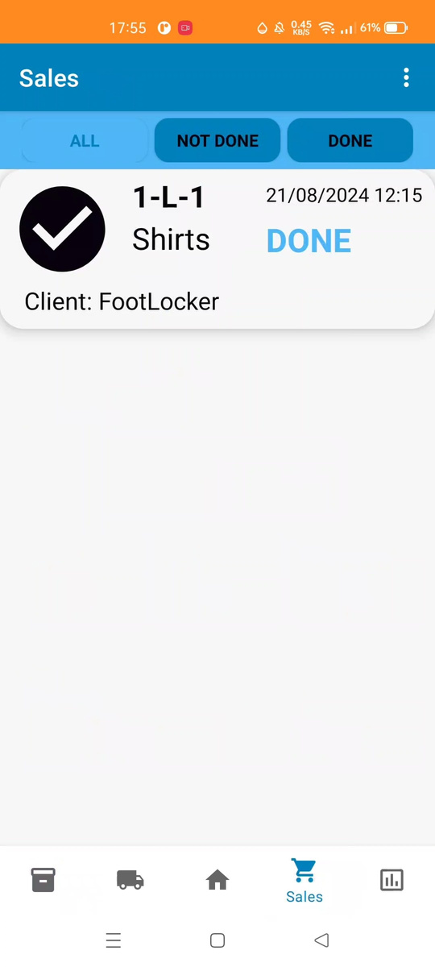
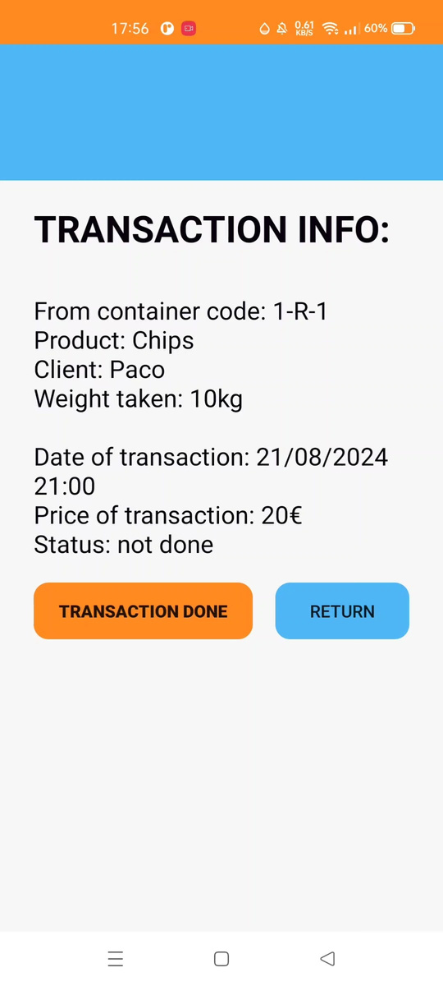
8.FEATURES: SALES
Sales:
Add Sale
Sales Fragment
Sales Info
Sale creation:
Container info
Press “sell product”
Fill form

Slide 18
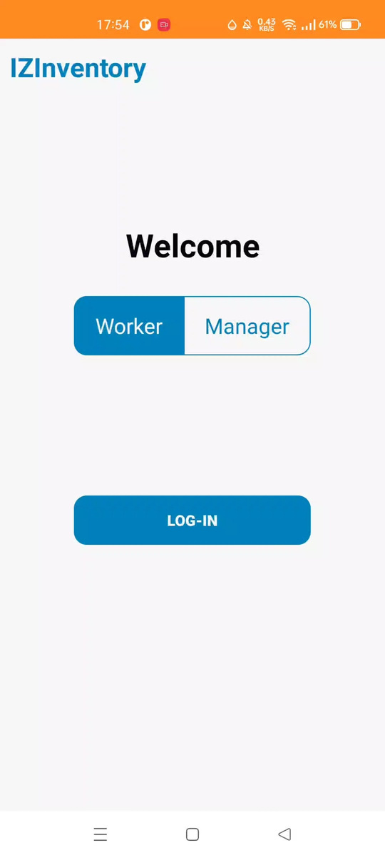
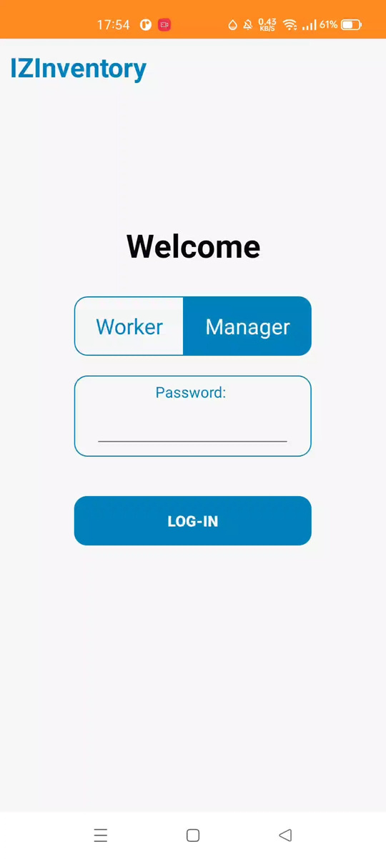
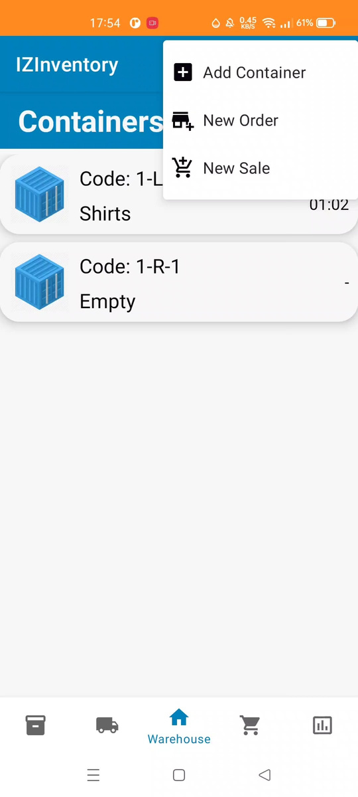
8.FEATURES: ROLES
Login
Manager (with password) or Worker
Tasks
Worker: - confirm order arrivals
- confirm sales done
Manager: create orders, containers and sales

Slide 19
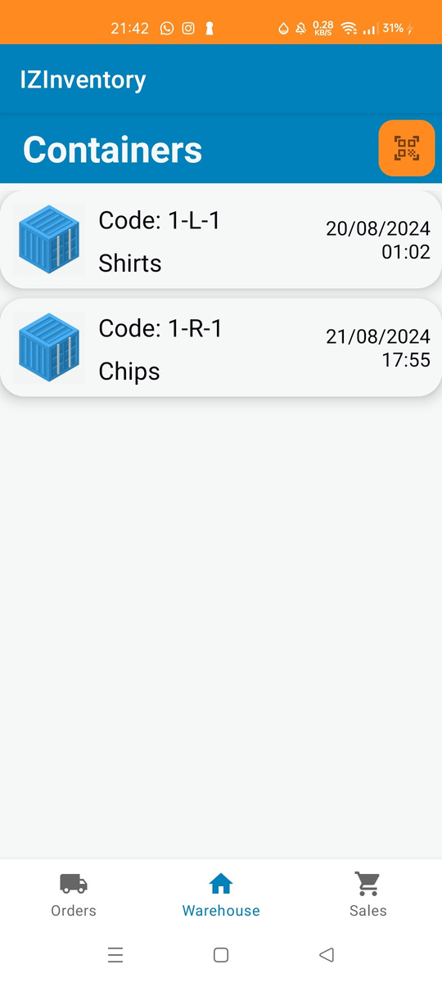
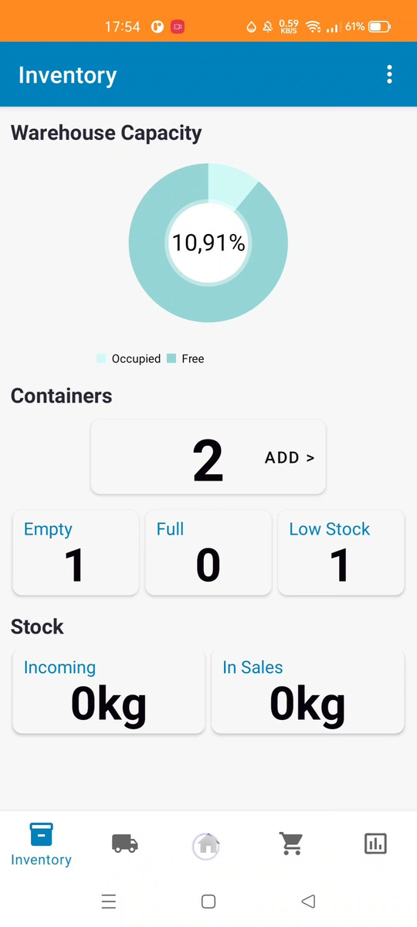
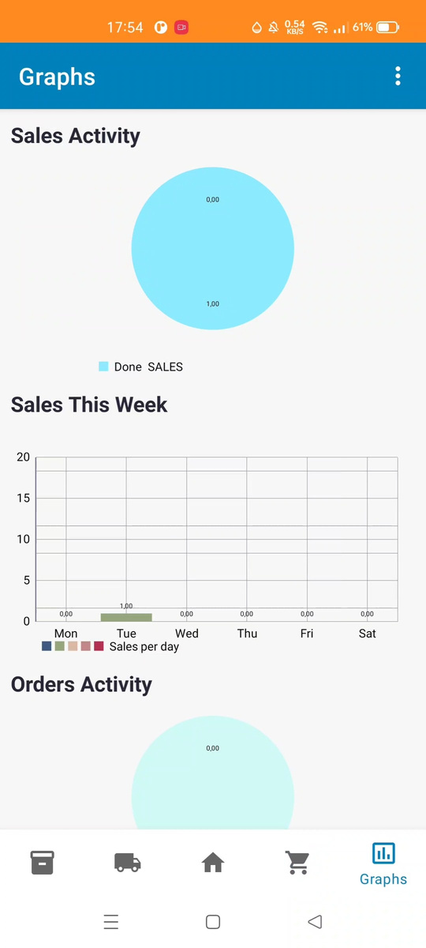
8.FEATURES: CHARTS
Workers P.O.V.
Inventory
Capacity graph
Add Container
Container situation
Stock situation
Graphs
Sales per weekday
Sales completed
Orders completed
This are examples, the client decides

Slide 20
9.CONCLUSIONS AND FUTURE LINES
The future for this project is adapting this application to a specific business situation.
Conclusions
Potential features
List of products
ID for workers
Change in inventory and graphs
Calendar view
Container QR code
Notifications
Computer application
And more...
I have met the objectives
Learned modern UI design

Slide 21
THANK YOU FOR YOUR TIME
Any questions?
Iker Zabalegui murugarren

